Slide 1
Java Utility Classes
presented by Anagha Suresh

Slide 2
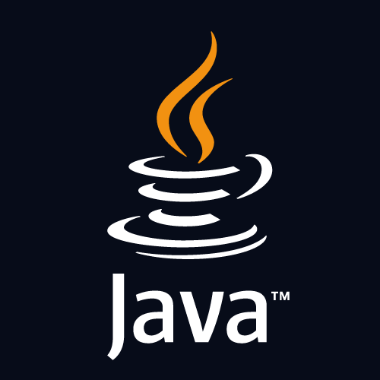
Introduction
In this presentation, we will learn about the key classes and methods that can significantly enhance your Java programming experience.

Slide 3
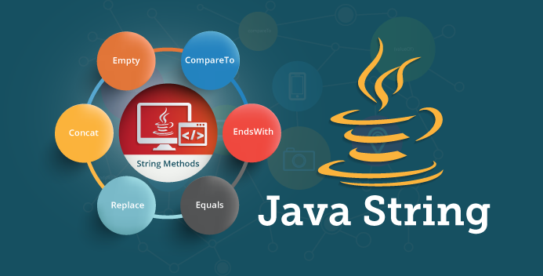
String Class
The String class is a fundamental utility class in Java, providing powerful methods for manipulating text.
Understanding its nuances can lead to significant improvements in string handling and performance.
The String class in Java is a fundamental component of the language's core library, residing in the java.lang package. It represents a sequence of characters and serves as a versatile tool for handling textual data in Java programs.

Slide 4
Collections Class
The Collections class offers a rich set of methods for managing collections in Java. Leveraging its capabilities can streamline your code and enhance the efficiency of working with lists, sets, and maps. The Collections class in Java, found in the java.util package, provides a variety of static utility methods for working with collections. These methods offer functionalities such as sorting, searching, synchronization, and more, allowing developers to efficiently manage and manipulate collections without having to implement these operations from scratch

Slide 5
File Class
The File class provides essential functionality for file and directory manipulation in Java. Exploring its methods can lead to more robust and efficient file handling within your applications. The File class in Java, located in the java.io package, provides essential functionality for file and directory manipulation. It represents the abstract pathname of files and directories in the file system. By using the methods provided by the File class, developers can perform various operations such as creating, deleting, renaming, and querying files and directories

Slide 6

Math Class
The Math class is a powerhouse of mathematical functions and constants. Utilizing its methods can lead to optimized mathematical operations and improved computational efficiency in Java programs. The Math class in Java, located in the java.lang package, serves as a powerhouse of mathematical functions and constants. It provides a wide range of methods for performing common mathematical operations, as well as constants representing mathematical values. By leveraging the functionalities offered by the Math class, developers can optimize mathematical operations and enhance computational efficiency in Java programs.

Slide 7

Date and Time Class
The Date and Time classes in Java offer comprehensive support for managing temporal data. Exploring these classes can lead to more efficient handling of dates, times, and time zones. The Date and Time classes in Java, primarily introduced in the java.time package (since Java 8), offer comprehensive support for managing temporal data. These classes provide a modern and powerful API for handling dates, times, time zones, durations, and more.

Slide 8

Input/Output Class
The Input/Output classes provide essential utilities for reading from and writing to streams in Java. Understanding these classes can lead to streamlined I/O operations and improved efficiency in handling data. The Input/Output (I/O) classes in Java, primarily found in the java.io and java.nio packages, provide essential utilities for reading from and writing to streams, files, and other data sources. Understanding and utilizing these classes can lead to streamlined I/O operations and improved efficiency in handling data.

Slide 9
Conclusion
In conclusion, learning Java Utility Classes increases the efficiency in your programming efforts. These classes offer a rich array of functionalities that can profoundly enhance the performance, reliability, and scalability of your Java applications. Whether it's managing collections, handling dates and times, performing mathematical operations, or facilitating input/output operations, these utility classes provide the building blocks for robust and efficient software development. By leveraging the capabilities of these classes effectively, you can streamline your code, reduce development time, and create Java applications that meet the highest standards of performance and quality.

Slide 10
Thank You!

